Slide 1

Tic Tac Toe with AI & Minimax Implementation
Joseph Veltri
Prof. Behzaden
May 2nd, 2021

Slide 2
Tic Tac Toe
The early Roman version was known as terni lapilli, or three pebbles at a time.
In the mid-1800s, Britain used the name noughts and crosses, with nought referring to the O’s (or zeros) used in the game. The phrase tick-tack-toe wasn’t used until the late 1800s
The US officially adopted the name tic tac toe in the 20th century.

Slide 3
MiniMax Algorithm
It is an algorithm used for optimal decision-making in game theory and artificial intelligence. Since these algorithms heavily rely on being efficient, the algorithm's performance can be heavily improved by using alpha-beta pruning.
Rules of many of these games are defined by legal positions and legal moves for every legal position. For every legal position it is possible to effectively determine all the legal moves. Some of the legal positions are starting positions and some are ending positions.

Slide 4
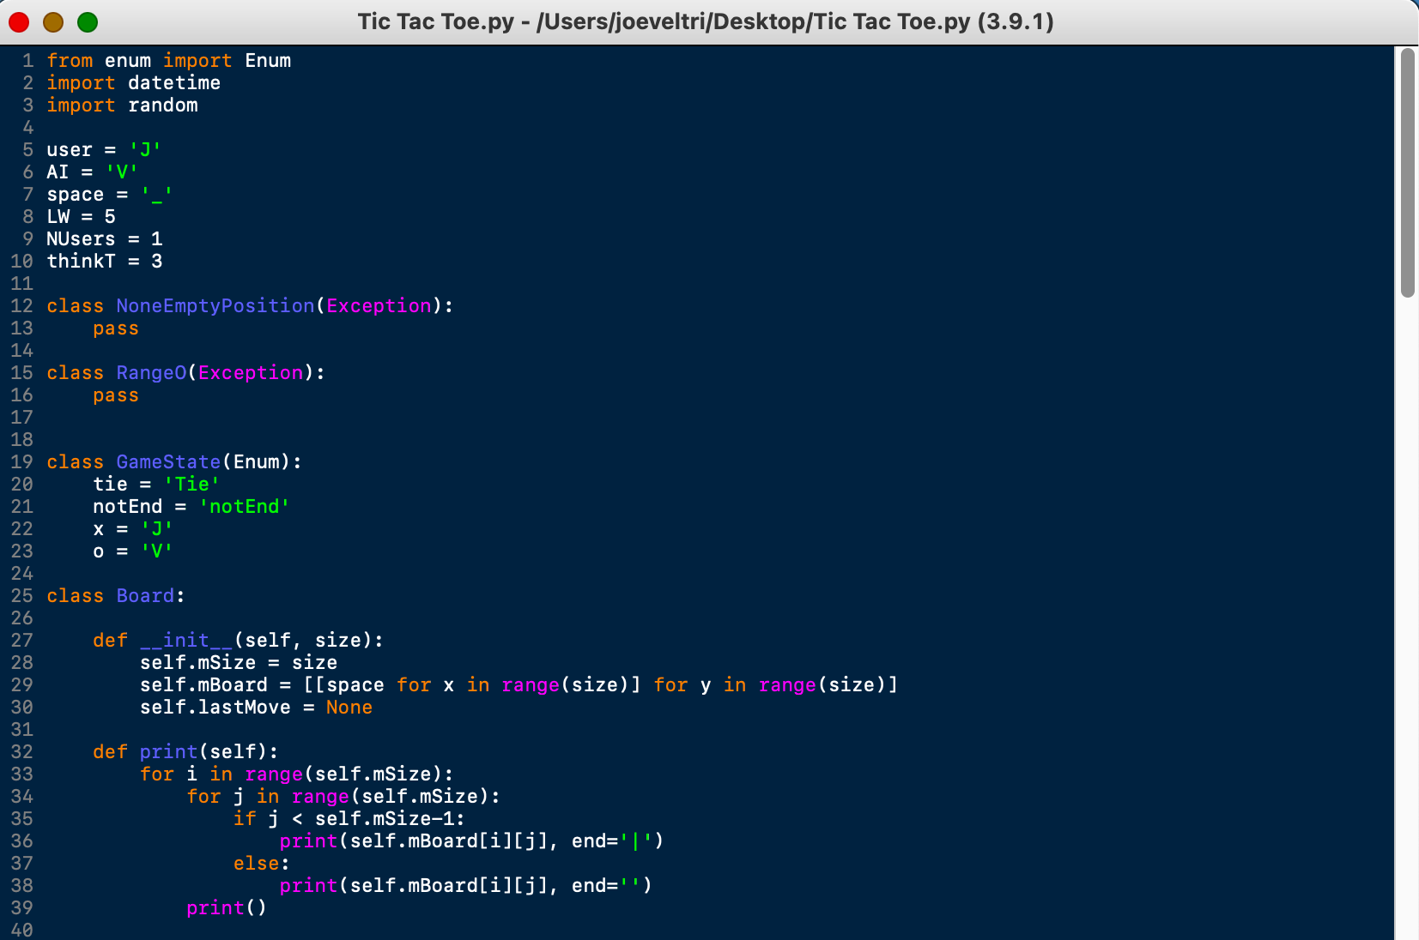

Slide 5
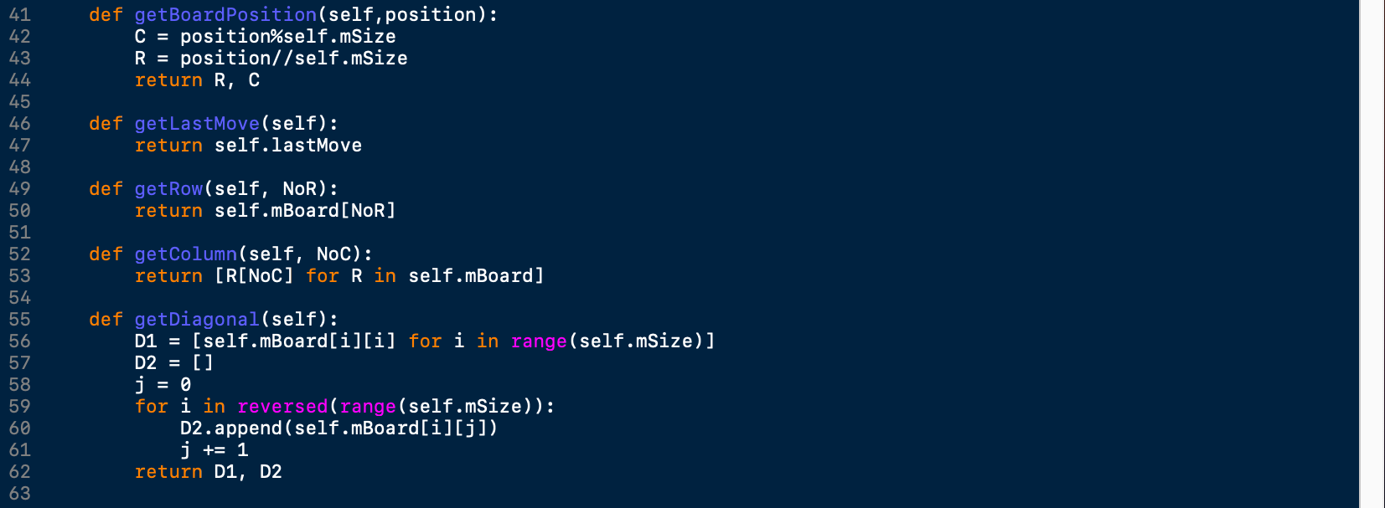

Slide 6
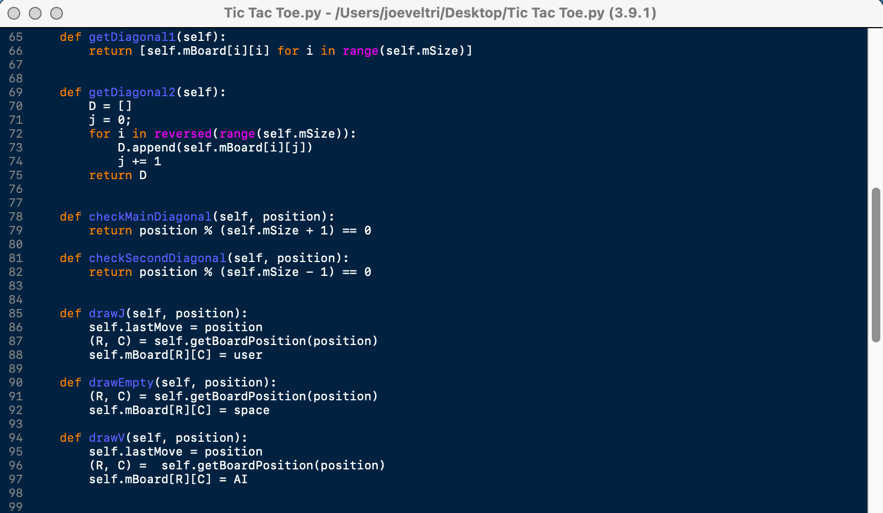

Slide 7
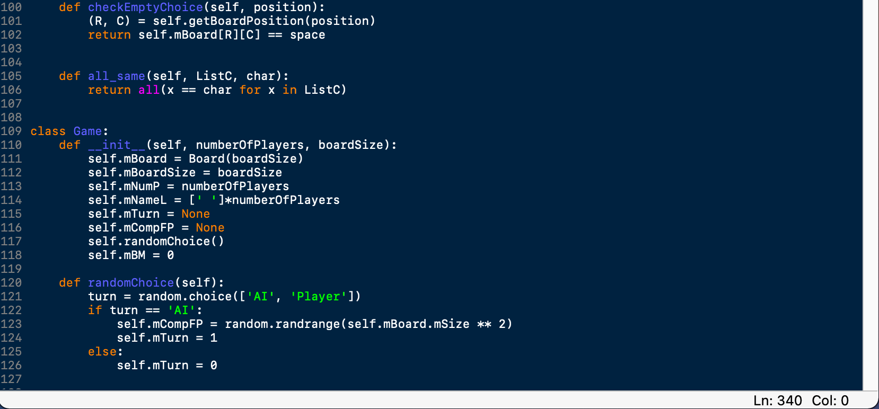

Slide 8
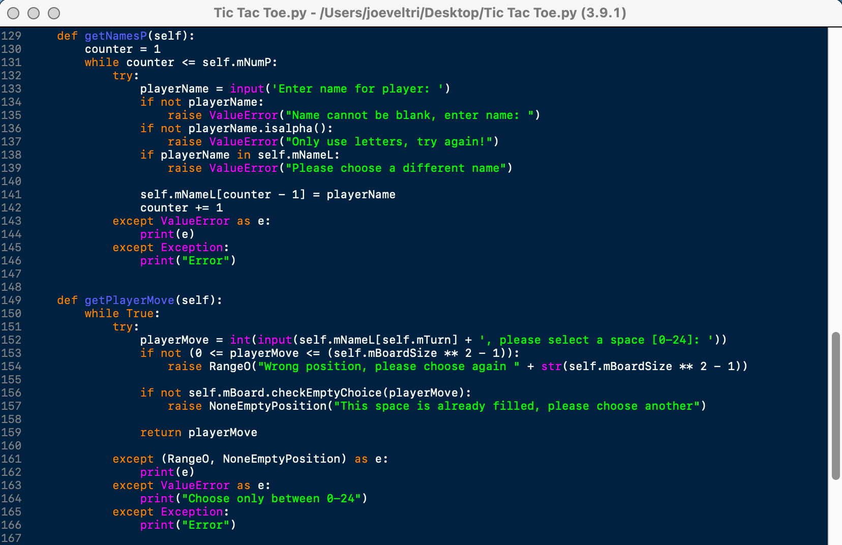

Slide 9
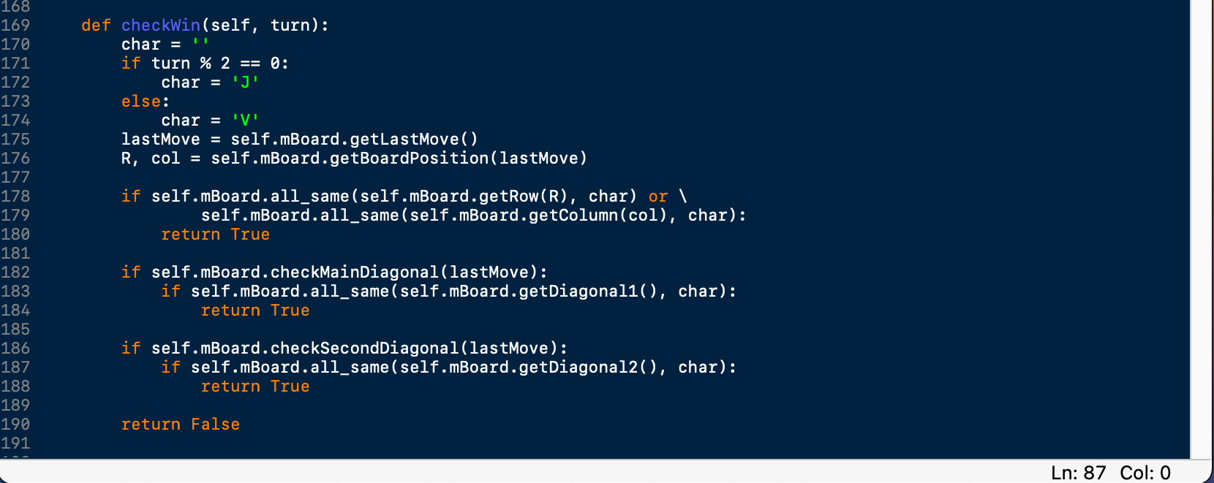

Slide 10
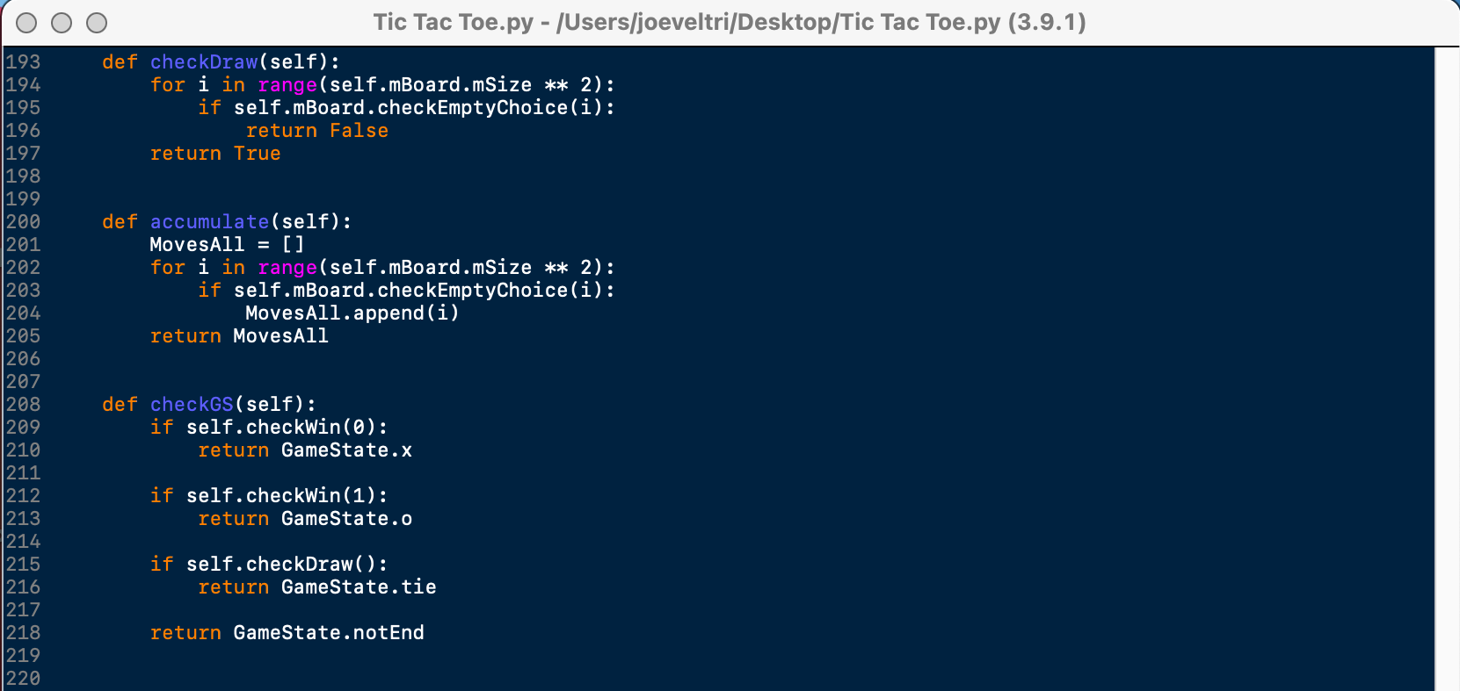

Slide 11
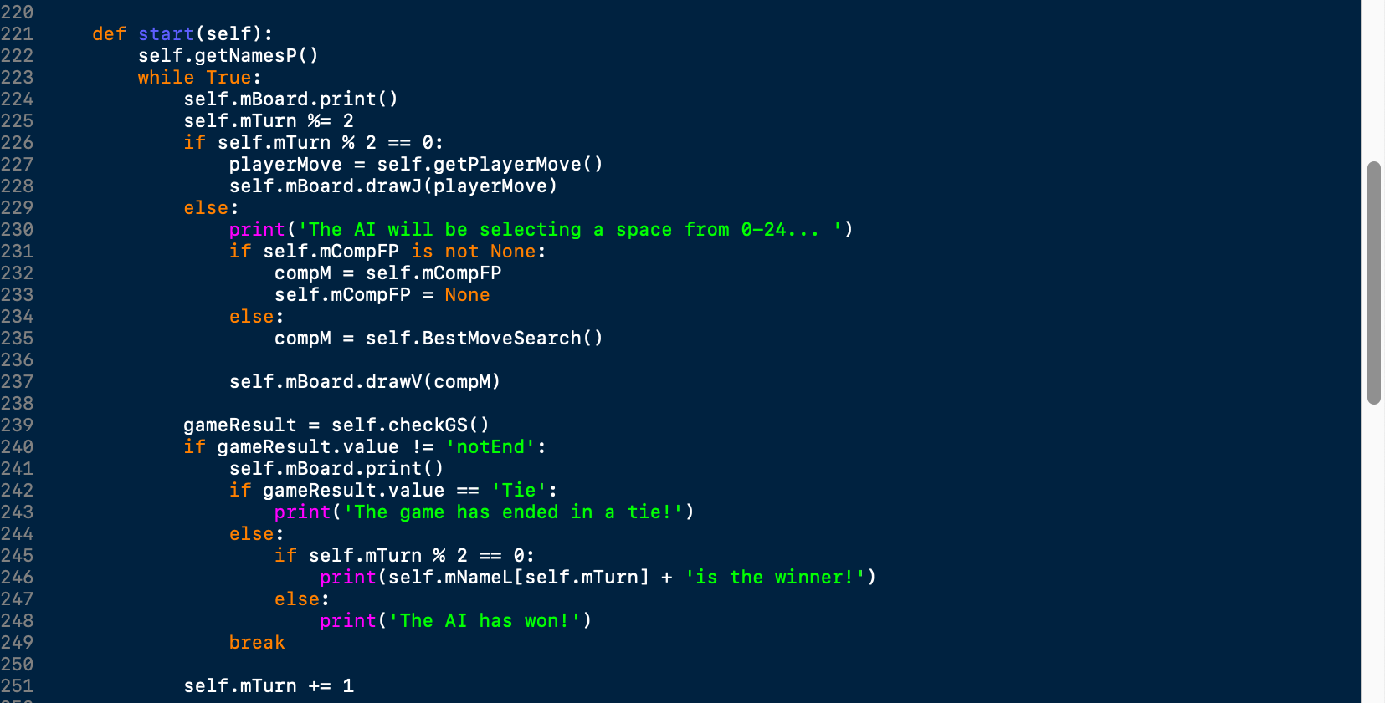

Slide 12
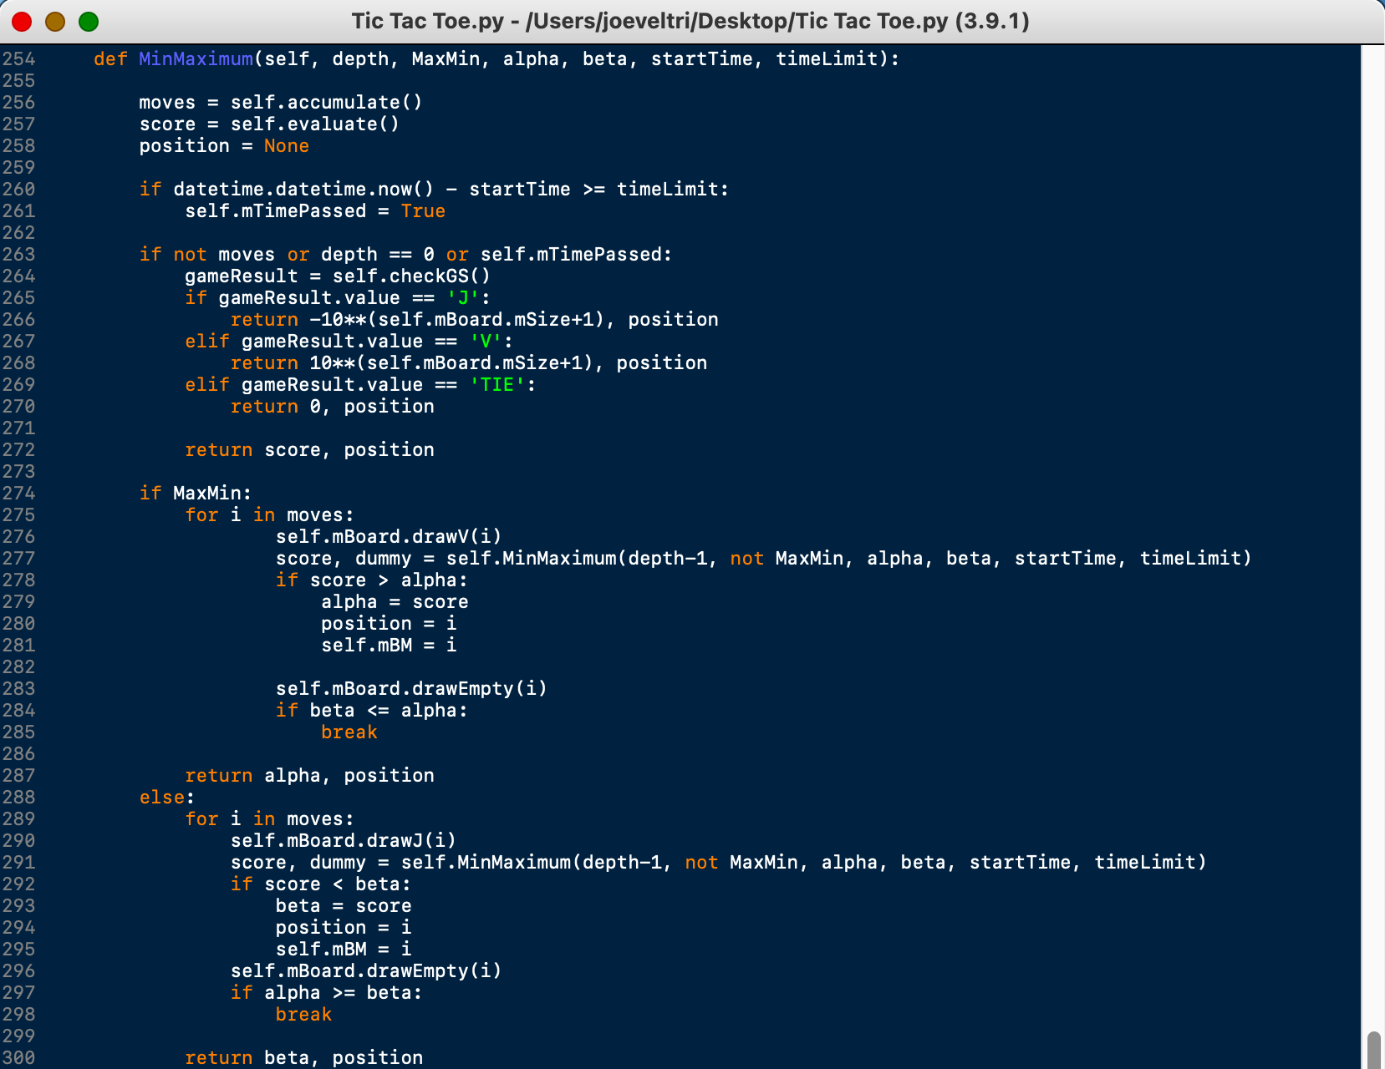

Slide 13
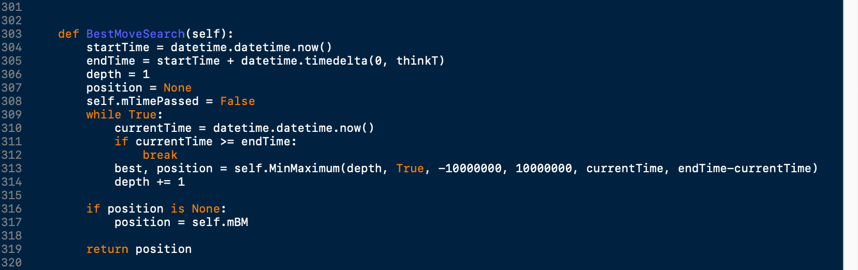

Slide 14
